Slide 1

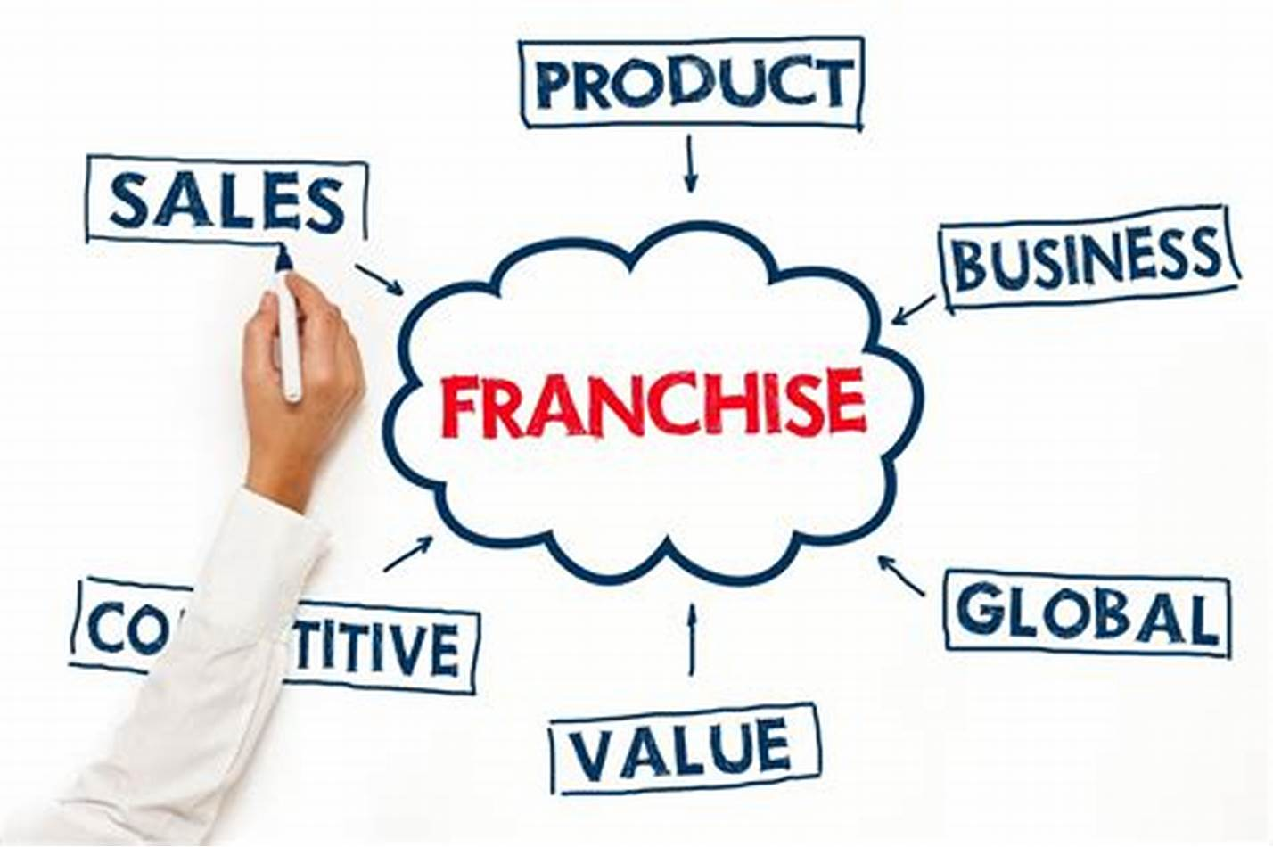
Sales Associates PROGRAM

Slide 2

Sales Associate Program – the New Frontier

Slide 3
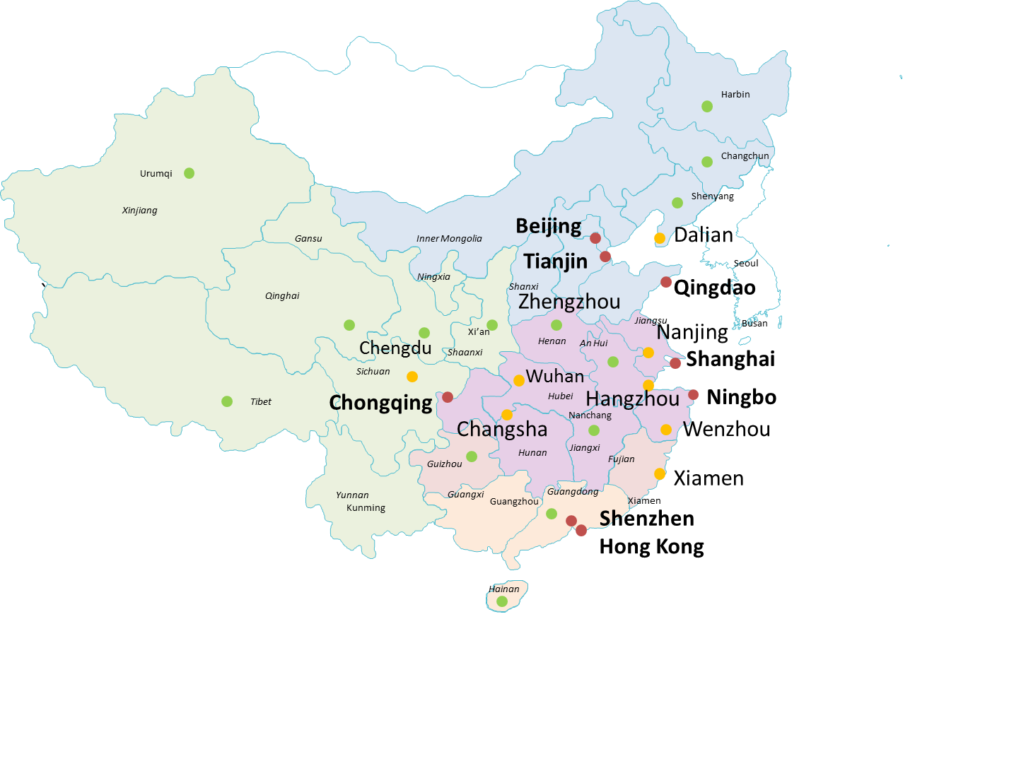

Existing BD Plan against DSA Program
\
SuZhou
Existing Branches Sales （ in plan ）15 by 2022
Branches (Strategic airfreight hub) to be launched 25 by 2023
In strategic plan , in full bloom , sales of under our Dextrans roof go to 50 in plan by 2023

Slide 4
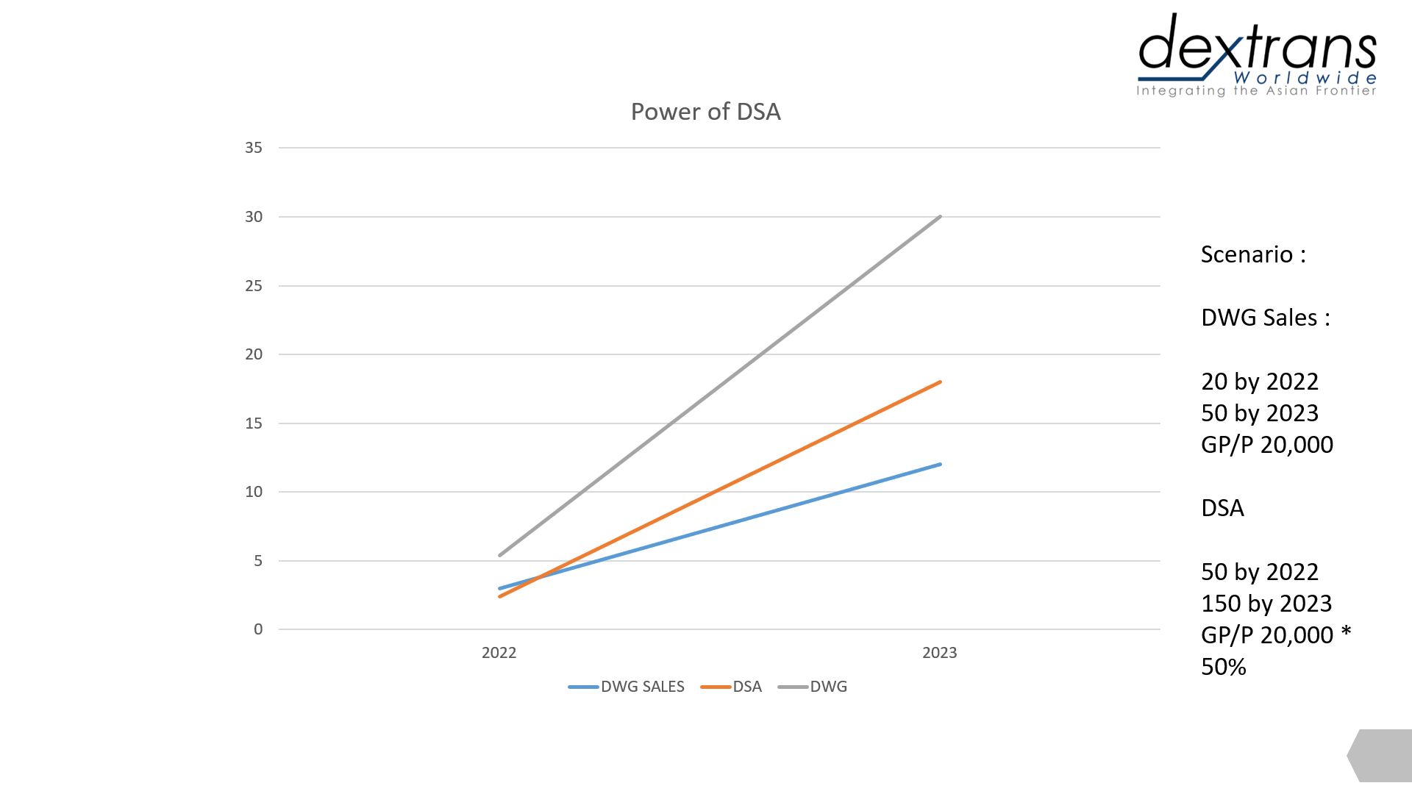
Exponential vs Linear Growth

Slide 5
TO DO ,HOPE
- to wait , nothing
For exponential growth in short time , we need to rely on leverage effect
There are two kinds of growth with leverage , capital leverage and human leverage , we go to the second one .
We are nimble and flexible for trial &error
We are not big boys , but small boat is actually more suitable to explore unknown waters and swerve quick enough in case of hidden icebergs
To be aggressive if we really need to make a change
The definition of aggressiveness , dare to try something with 50% chance of success
We can take freelance sales or sales partners as the prelude to further & deeper cooperation
There is no absolute boundary between sales partners and the part of Dextrans Group , things are interchangeable
Easier for us to go deeper into Tier 2 , Tier 3 cities
Business in less developed cities exists upon intertwined local relations , Franchising may be a way to penetrate it
Franchising business can benefit to our other key products
Our products like China Centric , air, overseas agents development need business to feed fat
.

Slide 6

What is Dextrans Sales Associate Program ?

Slide 7
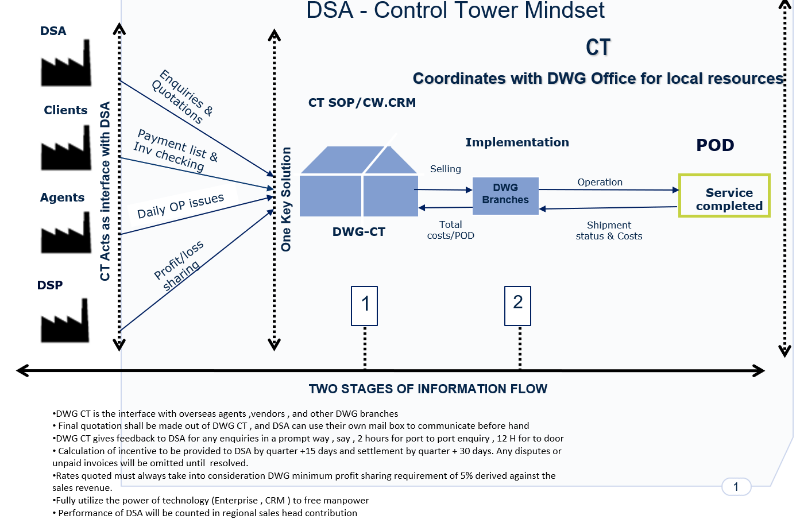

Slide 8
3 KINDS OF PEOPLE IN NEED
The people who can search sales partners in the market
Can be our existing staff , existing sales , personal relations , put it as part of hiring process , advertisement online
The people who can act as interface with sales partners
Control Tower / CS , providing sales support to sales agent , providing good services to clients brought in , can utilize
existing resources , and set up control tower in low cost cities
The people who can keep the operation smoothness , evaluate performance ,control risks
That can be put under the responsibilities of regional sales head , it can be part of their KPI , and the performance of sales
partners will be counted as team performance
The qualifications of the people for control tower
Young and energetic ,suitable for working in shifts , reasonable costs , attitude over experience , Bilingual speaking

Slide 9
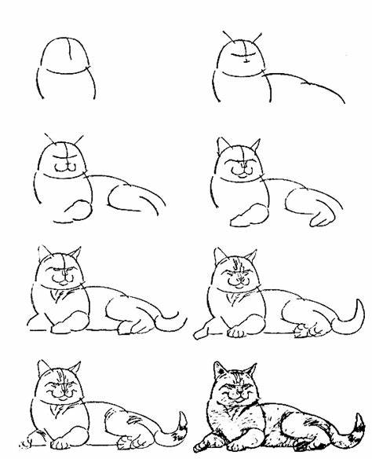
MOVE UP STEP BY STEP

Slide 10
DEVOTED AND NIMBLE
Start from 10 sales partners in China first
To use existing resources to sign up 10 sales partners as a trial within 3 months , we can see what are benefits / challenges in real life , without trials , nothing concrete can be told
Pay attention to risks control and cash flow safety
Strict with credit approval , for majority of cases , implement “ money in first then out “ to ease cash flow burden
Expand the number of sales partners in a more aggressive way
If the trial cases turn to be successful , we will construct control tower as soon , and expand the number of free sales to 50 within the year , and increase it to 150 by 6.30 / 2023
Keep the boundary vague between partners and Dextrans own staff
We keep our door open for any good people , keep sales partners as a talent pool for our full time positions .

Slide 11

Principles for DSA Program success
DSA must WIN
Sincerity
Reliability
Transparency
Simplicity

Slide 12
THANK YOU

